Slide 1
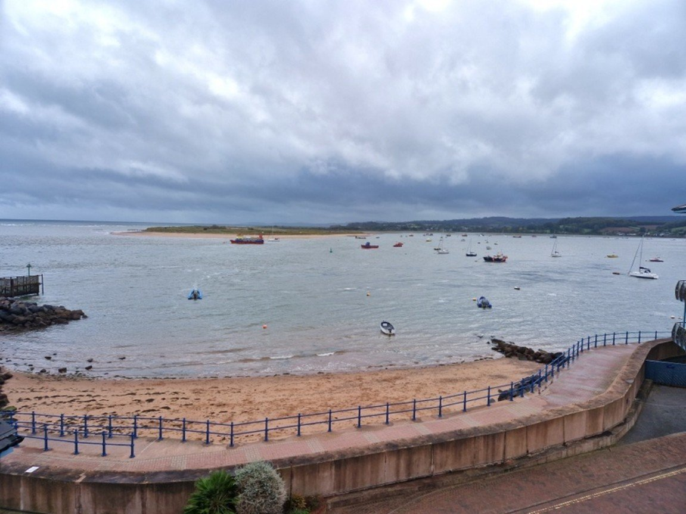
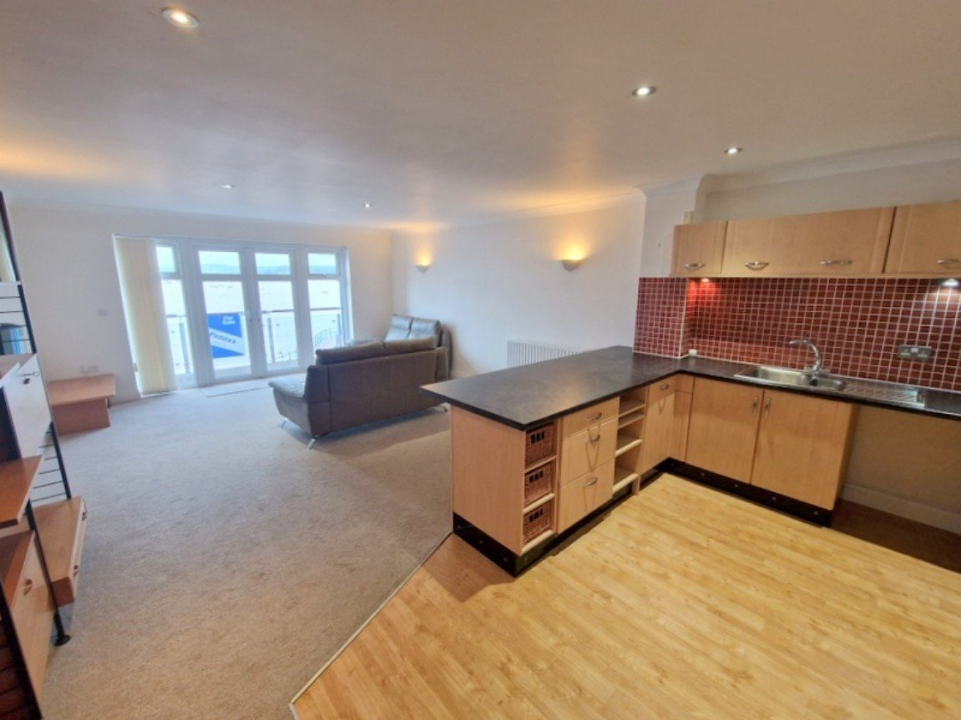
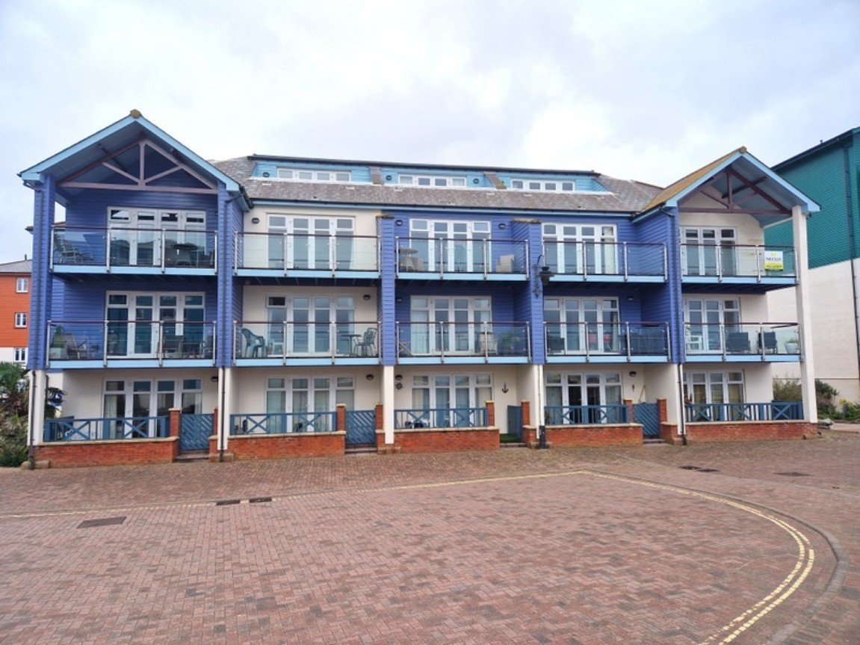
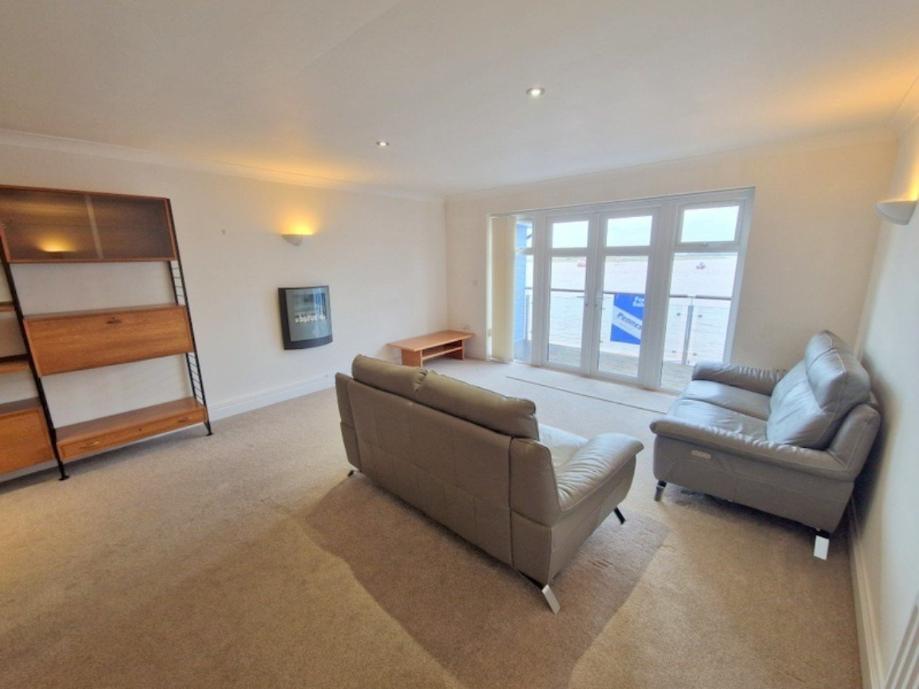
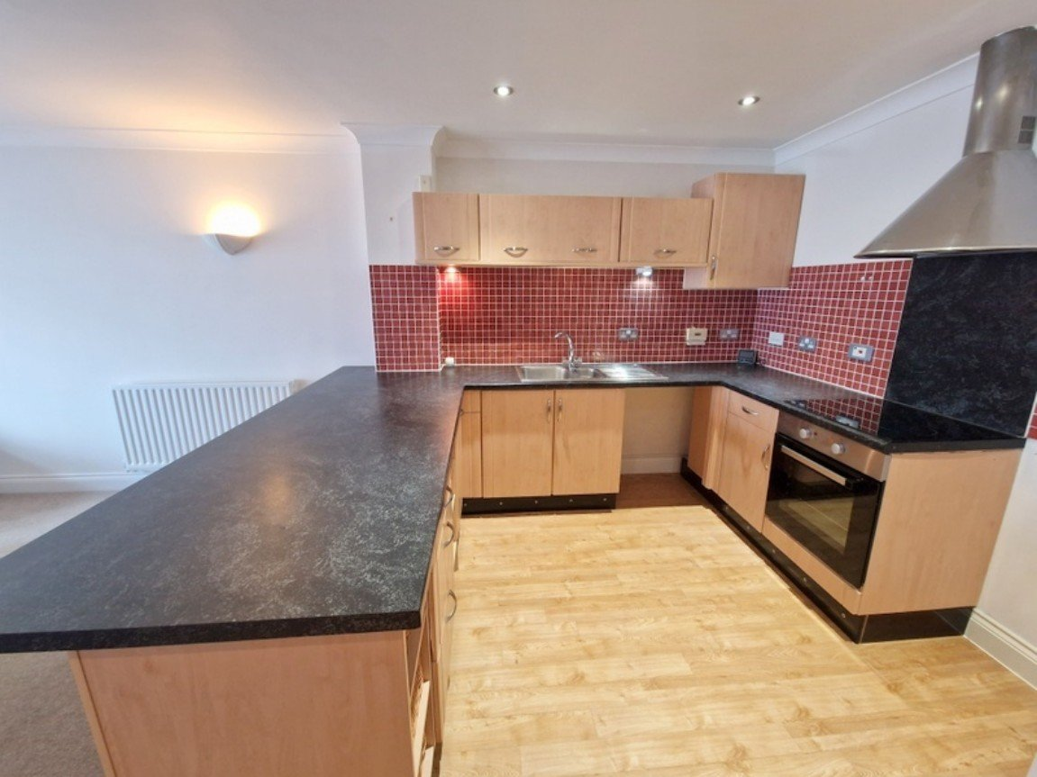
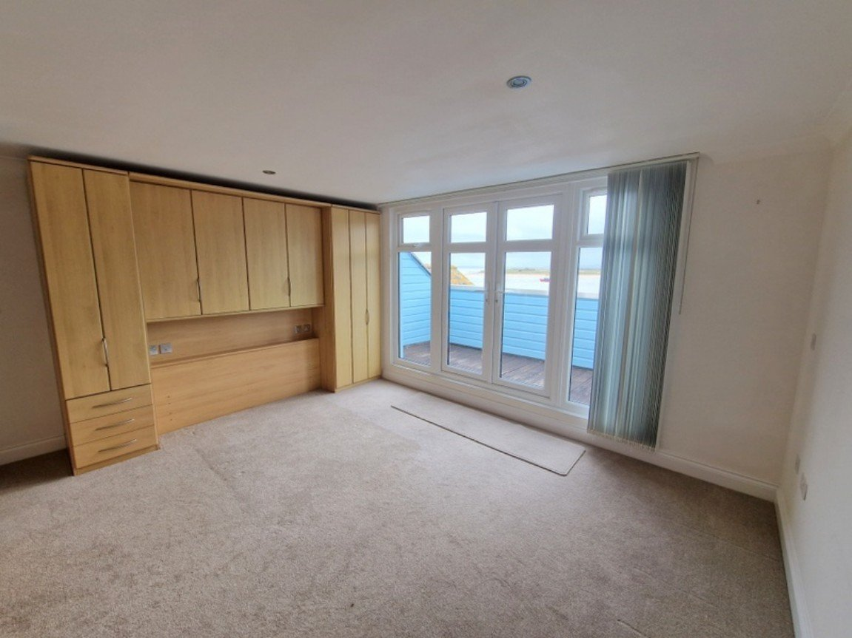
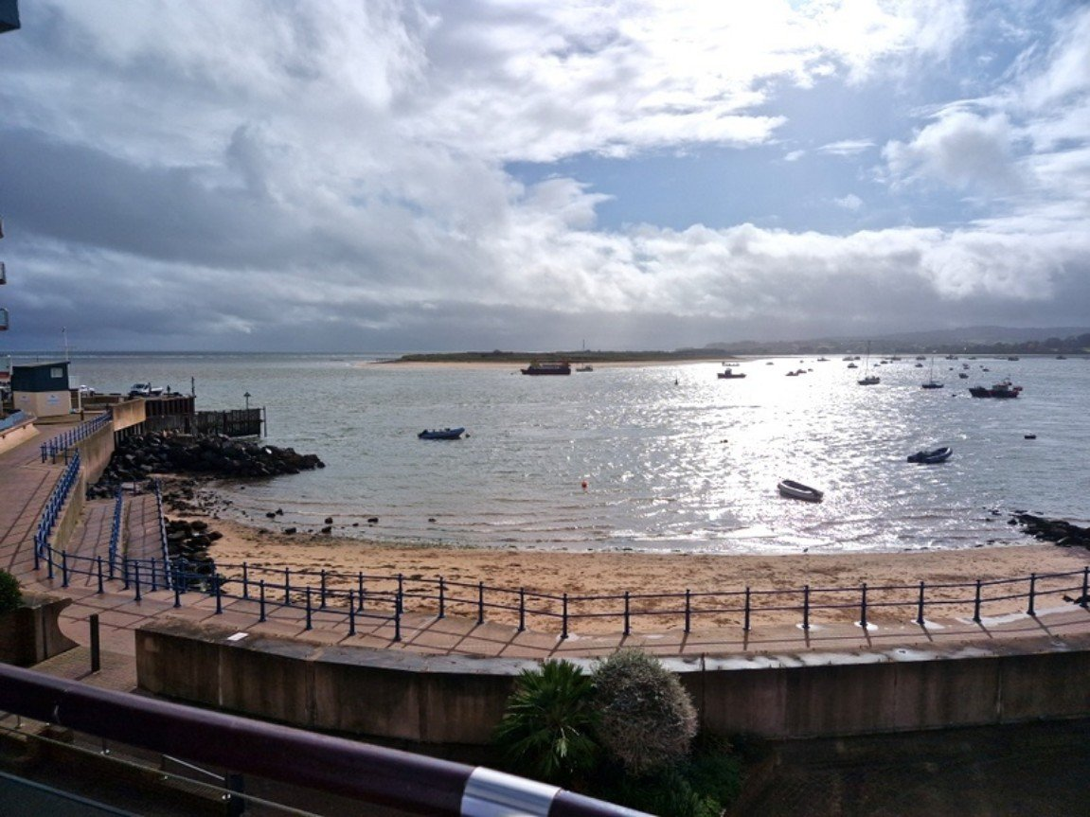
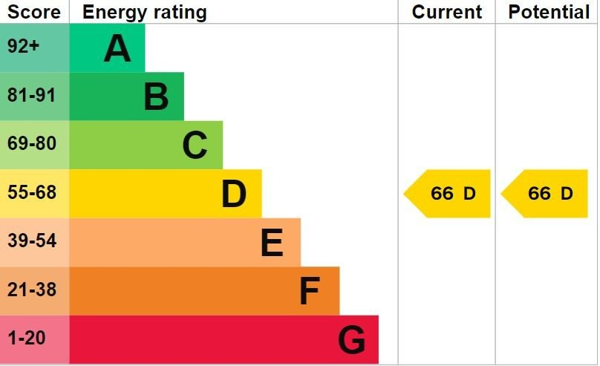
www.pennys.net
28 Madison Wharf, Shelly Road, Exmouth, EX8 1DA
GUIDE PRICE £439,950
TENURE Leasehold
A Wonderful Opportunity To Purchase A Duplex Apartment Located On Exmouth's Prestigious Marina Development With Stunning South Westerly Views Over The Estuary And Dawlish Warren
Open Plan Living Area And Well-Appointed Kitchen • Cloakroom/WC •
Sun Balcony Off Living Area •
Bedroom With Built-In Furniture And Sun Balcony • Bathroom/WC •
Efficient Electric Boiler • Double Glazed Windows •
Super Permeant Home Or Holiday Retreat • No Onward Chain •
Pennys Estate Agents Limited for themselves and for the vendor of this property whose agents they are give notice that:- (1) These particulars do not constitute any part of an offer or a contract. (2) All statements contained in these particulars are made without responsibility on the part of Pennys Estate Agents Limited. (3) None of the statements contained in these particulars are to be relied upon as a statement or representation of fact. (4) Any intending purchaser must satisfy himself/herself by inspection or otherwise as to the correctness of each of the statements contained in these particulars. (5) The vendor does not make or give and neither do Pennys Estate Agents Limited nor any person in their employment has any authority to make or give any representation or warranty whatever in relation to this property.
PENNYS ESTATE AGENTS
2 Rolle House, Rolle Street, Exmouth, Devon, EX8 2SN
Tel: 01395 264111 EMail: help@pennys.net

Slide 2
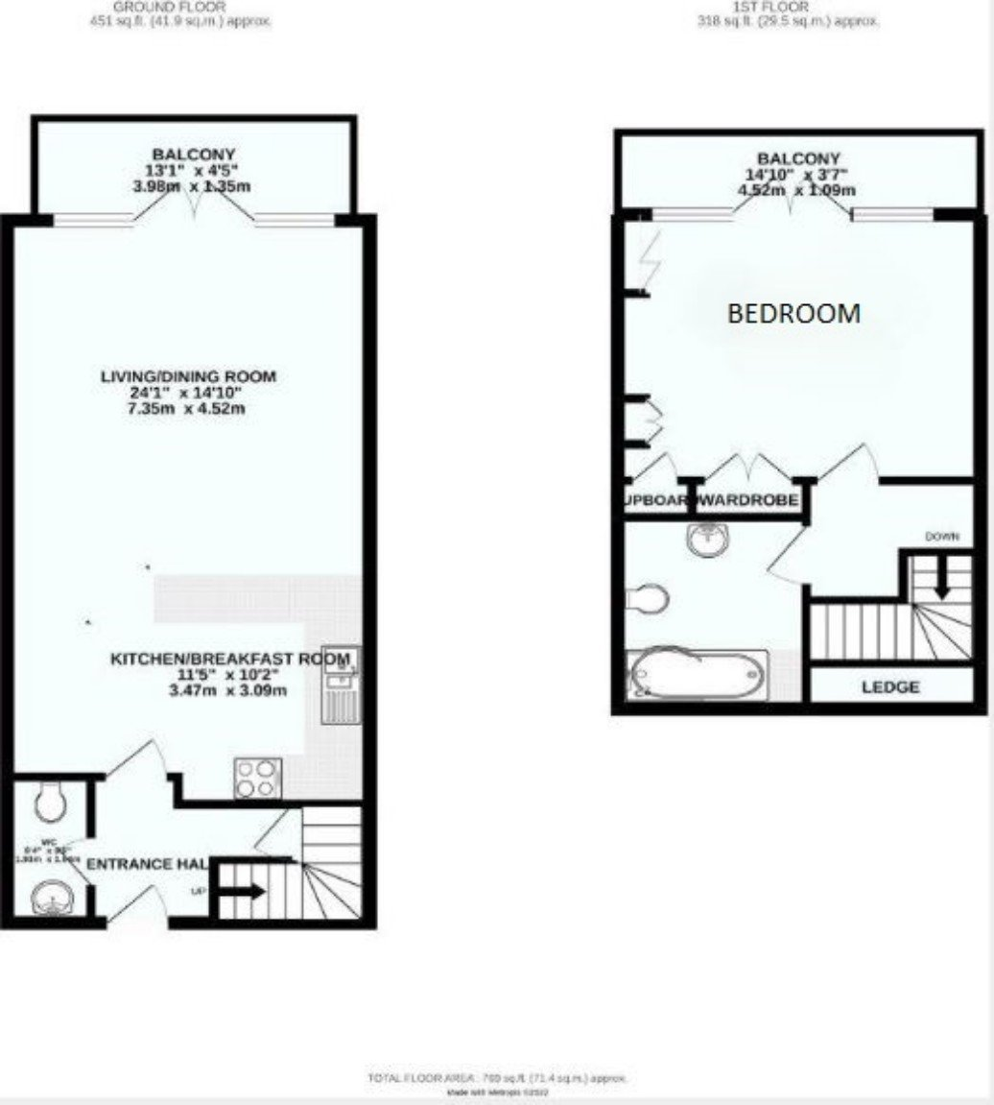
28 Madison Wharf, Shelly Road, Exmouth, EX8 1DA
THE ACCOMMODATION COMPRISES: Communal entrance door with entry system. Stairs and lift to SECOND FLOOR. Private front door to: RECEPTION HALL: Wood effect flooring; turning staircase to upper floor with good size understairs cupboard beneath; radiator; entry phone. OPEN PLAN KITCHEN BREAKFAST/LIVING ROOM: 7.34m x 4.52m (24'1" x 14'10") A stunning living space designed to take full advantage of the uninterrupted estuary and coastline views. KITCHEN AREA: Fitted with a range of work top surfaces which incorporates a breakfast area with cupboards and drawers beneath and plumbing for an automatic washing machine; integrated dishwasher beneath; inset one and a half bowl stainless steel sink unit with mixer tap; tiled surrounds; wall mounted cupboards; inset four ring electric hob with oven below and stainless steel extractor hood over; space for fridge freezer; wood effect flooring; ceiling LED spotlighting. LIVING AREA: Wall mounted living flame effect electric fire; television point; telephone point; recess ceiling spotlighting; radiator; double glazed picture windows and french patio doors onto SUN BALCONY 3.99m x 1.35m (13'1" x 4'5") with glass balustrade and stunning estuary views across to Dawlish Warren. CLOAKROOM/WC: Fitted with wash hand basin with cabinet beneath and mirror over; WC with concealed cistern and push button flush; extractor fan; radiator; wood effect flooring. FIRST FLOOR GALLERIED LANDING: With display area. BEDROOM: 4.5m x 3.51m (14'9" x 11'6") A stunning bedroom with a range of built-in quality bedroom furniture including wardrobes and drawer units; further built-in wardrobe housing electric boiler; cupboard housing water cylinder; recess ceiling LED spotlighting; television point; radiator; picture windows and french patio doors gaining wonderful coastline views and giving access to: SECOND SUN BALCONY 4.52m x 1.09m (14'10" x 3'7") with stunning views. BATHROOM/WC:B 2.54m x 2.36m (8'4" x 7'9") Bath with shower over with fixed rainfall shower and detachable shower hose; vanity wash hand basin with fitted mirror fronted medicine cabinet over with display light; WC with concealed cistern and push button flush; attractive extensively tiled walls; ceiling LED spotlighting; extractor fan; chrome heated towel rail. OUTSIDE: South westerly views cross the Estuary and Dawlish Warren offered via two balconies. GARAGE: 4.95m x 2.69m (16'3" x 8'10") With electric up and over door; boarded storage in roof eaves; power and light connected.
TENURE AND OUTGOINGS: The property is leasehold and held on a 125 year lease from 2002. We understand the service charges are approximately £2056.61 per annum and ground rent is £291 per annum.
FLOOR PLAN:

